Slide 1
OVERVIEW
As part of its planned growth, the company is getting into the aviation industry by buying and operating aircraft for private and commercial customers. Given the complexities and risks associated with flying, a thorough risk assessment is necessary to identify which aircraft types are the safest and most reliable for investment.

Slide 2
Business Understanding
This analysis's primary goal is to evaluate different aircraft models according to safety, operating hazards, accidents, and general dependability. The results will offer practical advice to help the business choose aircraft that reduce risk while maintaining profitability and legal compliance.

Slide 3
Data Understanding
.
Information regarding civil aviation accidents and specific events in the United States, including variables like aircraft characteristics and accident severity, are included in the dataset utilised for this study. To gain a thorough grasp of the dataset, explanatory data analysis approaches will be employed, such as addressing missing values, verifying data types, and extracting pertinent characteristics for study.

Slide 4
Data Analysis
Since most accidents happen under VMC, it is likely that operational or human variables have a greater influence than environmental elements, such as the weather.
Despite having a high accident rate, manufacturers such as Cessna, Piper, and Beech continue to have relatively low death rates. This implies that even though these planes are involved in more accidents, few people are perish.

Slide 5
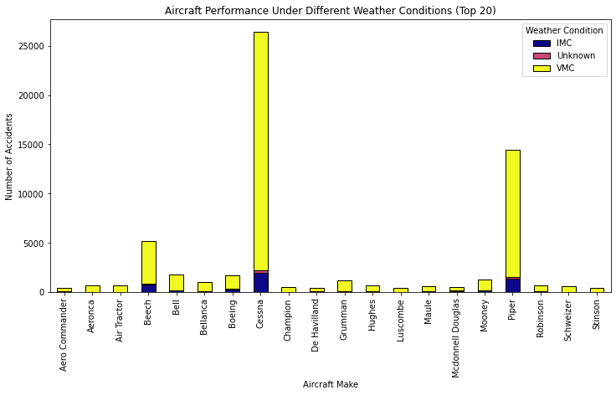

Slide 6
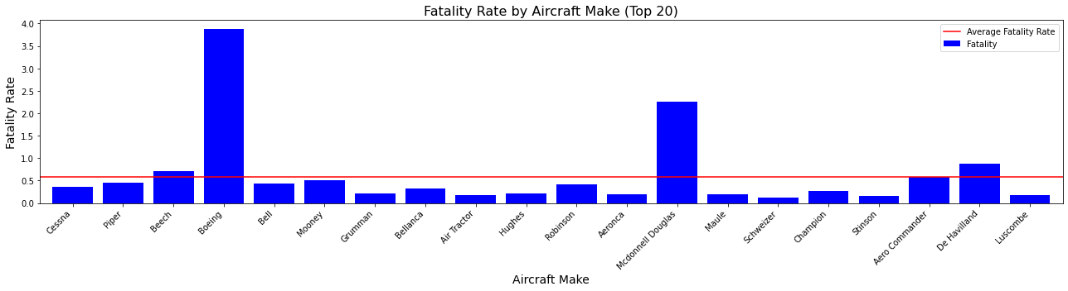

Slide 7
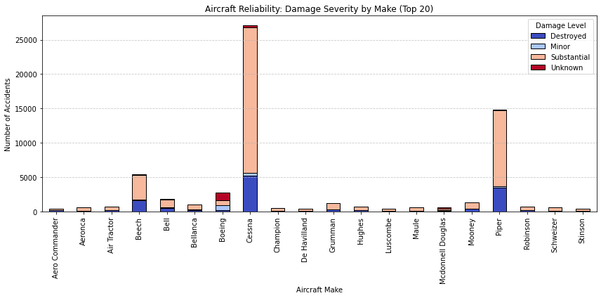

Slide 8
Recommendations
To reduce hazards, the corporation should concentrate on purchasing aircraft models with lower fatality rates.
- To improve risk management in Instrument Meteorological Conditions (IMC), the organization ought to fund pilot training initiatives.
- To lower mechanical failures, pre-flight inspections, predictive maintenance technologies, and routine maintenance should be used.

Slide 9
THANK YOU !

